Slide 1
SOFTWARE QUALITY ASSURANCE

Slide 2
SQA (Quality Management)
People and Quality
The problem of quality management is not what people don’t know about it. The problem is what they think they do know. . . .
SQA is an Umbrella Activity
Umbrella activities are a set of steps or procedure that the software engineering team follows to maintain the progress, quality, change and risks of the overall development tasks

Slide 3
SQA (Quality Management)
Quality control and Assurance are essential activities for any business.
SQA is a “planned and systematic pattern of actions” that are required to ensure high quality in software.

Slide 4
Elements of SQA
There are some broad range of concerns and activities that focus on the management of software quality.
Standards:
The IEEE, ISO standards.
Standards may be adopted for the development of a software.
Reviews and Audits:
Technical reviews for quality control. Their intent is to uncover errors.
Audits are a type of review. Ensures quality guidelines are being followed.

Slide 5
Elements of SQA
Testing:
A quality control function.
Its primary goal is to find errors. SQA ensures that the testing properly planned and efficiently conducted
Error/Defect collection and Analysis:
SQA collects and analyses error.
How errors are introduced?
How to eliminate errors.

Slide 6
Elements of SQA
Change Management:
One of the most disruptive aspects of SE.
Proper management of change is needed.
Change → Confusion → Poor quality
SQA ensures change management
Education:
Improvement is necessary for SE practices.
Education to software engineers, their managers and other stakeholders.

Slide 7
Elements of SQA
Vendor Management:
Three categories of software are acquired from external software vendors.
1. Shrink wrapped packages
2. A tailored shell. Basic skeletal structure that is custom tailored.
3. Contracted software.
Security Management:
Every organization should institute policies that protect data at all levels.
Firewall protection
SQA ensures that appropriate processes and technology are used.

Slide 8
Elements of SQA
Safety:
Impact of hidden defects can be catastrophic.
SQA should initiate those steps required to reduce risk.
Risk Management:
SQA ensures that the risk management activities are properly conducted.

Slide 9
SQA Tasks
2 different constituencies
The software engineers who do technical work.
An SQA group.
Quality assurance planning
Oversight
Record keeping
Analysis
Reporting

Slide 10
SQA Tasks
Software Engineering Institute recommends a set of SQA actions.
These actions can be performed by an independent SQA group.

Slide 11
SQA Tasks
Prepares an SQA plan for a project:-
Plan identifies,
Evaluations to be performed
Audits and reviews to be conducted
Standards
Procedures for error reporting and tracking
Work products that are produced
Feedbacks

Slide 12
SQA Tasks
Participates in the development of the project’s software process description:-
Software team selects a process for the work.
SQA group reviews the process description for compliances,
Organizational policy
Internal software standards
Externally imposed standards, etc.

Slide 13
SQA Tasks
Participates in the development of the project’s software process description:-
Software team selects a process for the work.
SQA group reviews the process description for compliances,
Organizational policy
Internal software standards
Externally imposed standards, etc.

Slide 14
SQA Tasks
Audits to verify compliance with software process:-
SQA group reviews selected work products;
Identifies
Documents
Tracks deviations
Verifies that corrections have been made.
Periodically reports the results.

Slide 15
SQA Tasks
Ensures that deviations are documented and handled:-
Deviations in,
Project plan
Process description
Applicable standards
SE work products

Slide 16
SQA Tasks
Records any noncompliance and reports to senior management:-
Noncompliance items are tracked until they are resolved.

Slide 17
SQA Goals
Requirements quality:-
correctness
completeness
Consistency
SQA must ensure proper review of the requirements model.

Slide 18
SQA Goals
Design quality:-
Every element of the design model should be assessed.
SQA looks for attributes of the design that are indicators of quality.

Slide 19
SQA Goals
Code quality:-
Source code and related work products.
SQA ensures the quality of the code.

Slide 20
SQA Goals
Quality control effectiveness:-
A software team should apply limited resources.
SQA analyses the allocation of resources for reviews and testing to assess whether they are allocated in the most effective manner.

Slide 21
Formal approaches to SQA
It can be argued that a computer program is a mathematical object.
It should be possible to apply mathematic proof of correctness to demonstrate that a program conforms exactly to its specifications.

Slide 22
STATISTICAL SOFTWARE QUALITY ASSURANCE
To become more quantitative about quality.
For software, statistical quality assurance implies the following steps:
Information about software errors and defects is collected and categorized.
An attempt is made to trace each error and defect to its underlying cause.
Using the Pareto principle (80 percent of the defects can be traced to 20 percent of all possible causes), isolate the 20 percent (the vital few).
Once the vital few causes have been identified, move to correct the problems that have caused the errors and defects.

Slide 23
Six Sigma for Software Engineering
Six Sigma is the most widely used strategy for statistical quality assurance in industry today.
Six Sigma strategy “is a rigorous and disciplined methodology that uses data and statistical analysis to measure and improve a company’s operational performance by identifying and eliminating defects’ in manufacturing and service-related processes”.

Slide 24
Six Sigma for Software Engineering
The Six Sigma methodology defines three core steps:
Define customer requirements and deliverables and project goals via well defined methods of customer communication.
Measure the existing process and its output to determine current quality performance.
Analyse defect metrics and determine the vital few causes.

Slide 25
Six Sigma for Software Engineering
If an existing software process is in place, but improvement is required, Six Sigma suggests two additional steps:
Improve the process by eliminating the root causes of defects.
Control the process to ensure that future work does not reintroduce the causes of defects.

Slide 26
SOFTWARE RELIABILITY
“The probability of failure-free operation of a computer program in a specified environment for a specified time”.
Whenever software reliability is discussed, a pivotal question arises: What is meant by the term failure?
Failures can be only annoying or catastrophic.

Slide 27
Measures of Reliability and Availability
In hardware, failures due to physical wear.
All software failures can be traced to design or implementation problems;
A simple measure of reliability is meantime- between-failure (MTBF).
MTBF = MTTF + MTTR
where the acronyms MTTF and MTTR are mean-time-to-failure and mean-time-to-repair, respectively.

Slide 28
Measures of Reliability and Availability
In hardware, failures due to physical wear.
All software failures can be traced to design or implementation problems;
A simple measure of reliability is meantime- between-failure (MTBF).
MTBF = MTTF + MTTR
where the acronyms MTTF and MTTR are mean-time-to-failure and mean-time-to-repair, respectively.

Slide 29
Measures of Reliability and Availability
An alternative measure of reliability is failures-in-time (FIT)—a statistical measure of how many failures a component will have over one billion hours of operation. Therefore, 1 FIT is equivalent to one failure in every billion hours of operation.

Slide 30
Measures of Reliability and Availability
Software availability is the probability that a program is operating according to requirements at a given point in time and is defined as,
Availability = ( MTTF/MTTF +MTTR ) *100

Slide 31
Software Safety
Software safety is a software quality assurance activity that focuses on the identification and assessment of potential hazards that may affect software negatively and cause an entire system to fail.
Initially, hazards are identified and categorized by criticality and risk.

Slide 32
Software Testing Strategies
What is it?
Software is tested to uncover errors that were made inadvertently as it was designed and constructed.
Testing is a set of activities that can be planned in advance and conducted systematically.

Slide 33
Software Testing Strategies
Who does it?
A strategy for software testing is developed by the project manager, software engineers, and testing specialists.
Why is it important?
Testing often accounts for more project effort than any other software engineering action.
If it is conducted haphazardly, time is wasted, and unnecessary effort is expended, and even worse, errors sneak through undetected.
It would therefore seem reasonable to establish a systematic strategy for testing software.

Slide 34
A Strategic Approach to Testing Strategies
A number of software testing strategies have been proposed.
All provide you with a template for testing and all have the following generic characteristics:
To perform effective testing, you should conduct effective technical reviews.
Testing begins at the component level and works “outward” toward the integration of the entire computer-based system.
Different testing techniques are appropriate for different software engineering approaches and at different points in time.

Slide 35
A Strategic Approach to Testing Strategies
Testing is conducted by the developer of the software and (for large projects) an independent test group.
Testing and debugging are different activities, but debugging must be accommodated in any testing strategy.

Slide 36
Verification and Validation
Verification
“Are we building the product right?”
Validation
“Are we building the right product?”

Slide 37
Verification and Validation
Software testing is one element of a broader topic that is often referred to as verification and validation (V&V).
Verification refers to the set of tasks that ensure that software correctly implements a specific function.
Validation refers to a different set of tasks that ensure that the software that has been built is traceable to customer requirements.

Slide 38
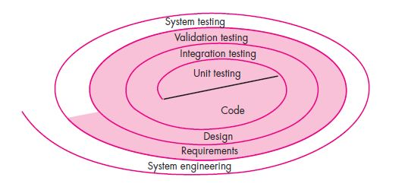
Software Testing Strategy—The Big Picture
The software process may be viewed as a spiral structure.

Slide 39
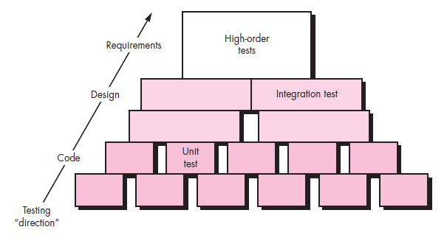
Software Testing Strategy—The Big Picture
Considering the process from a procedural point of view, testing within the context of software engineering is actually a series of four steps that are implemented sequentially.

Slide 40
Criteria for Completion of Testing
“When are we done testing?”
“How do we know that we’ve tested enough?”

Slide 41
STRATEGIC ISSUES
Specify product requirements in a quantifiable manner long before testing commences.
State testing objectives explicitly
Understand the users of the software and develop a profile for each user category.
Develop a testing plan that emphasizes “rapid cycle testing.
Build “robust” software that is designed to test itself.

Slide 42
STRATEGIC ISSUES
Use effective technical reviews as a filter prior to testing.
Conduct technical reviews to assess the test strategy and test cases themselves.
Develop a continuous improvement approach for the testing process.

Slide 43
TEST STRATEGIES FOR CONVENTIONAL SOFTWARE
There are many strategies that can be used to test software.
(1)
You can wait until the system is fully constructed.
Then conduct tests on the overall system in hopes of finding errors.

Slide 44
TEST STRATEGIES FOR CONVENTIONAL SOFTWARE
There are many strategies that can be used to test software.
(2)
You could conduct tests on a daily basis, whenever any part of the system is constructed.

Slide 45
TEST STRATEGIES FOR CONVENTIONAL SOFTWARE
It takes an incremental view of testing.
Beginning with the testing of individual program units.
Moving to tests designed to facilitate the integration of the units.
Culminating with tests that exercise the constructed system.

Slide 46
TEST STRATEGIES FOR CONVENTIONAL SOFTWARE
1. Unit Testing
Unit testing focuses verification effort on the smallest unit of software design —the software component or module.
Using the component-level design description as a guide.
Important control paths are tested to uncover errors within the boundary of the module.
The unit test focuses on the internal processing logic and data structures within the boundaries of a component.
This type of testing can be conducted in parallel for multiple components.
The main aim is to isolate each unit of the system to identify, analyse and fix the defects.

Slide 47
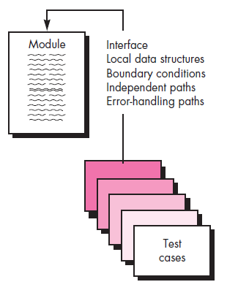
Unit-test considerations
The module interface is tested to ensure that information properly flows into and out of the program unit under test.
Local data structures are examined to ensure that data stored temporarily maintains its integrity during all steps in an algorithm’s execution.

Slide 48
Unit-test considerations
Ensure that all statements in a module have been executed at least once.
All error-handling paths are tested.
Test cases should be designed to uncover errors due to erroneous computations, incorrect comparisons, or improper control flow.

Slide 49
Unit-test considerations
Boundary testing is one of the most important unit testing tasks.
Software often fails at its boundaries.
That is, errors often occur when the nth element of an n-dimensional array is processed.

Slide 50
Unit-test considerations
Boundary testing
An exam has a pass boundary at 50 percent, merit at 75 percent and distinction at 85 percent. The Valid Boundary values for this scenario will be as follows:
49, 50 – for pass
74, 75 – for merit
84,85 – for distinction
Boundary values are validated against both the valid boundaries and invalid boundaries.
0 - for lower limit boundary value
101 – for upper limit boundary value

Slide 51
TEST STRATEGIES FOR CONVENTIONAL SOFTWARE
Integration Testing
“If they all work individually, why do you doubt that they’ll work when we put them together?”
The problem, of course, is “putting them together”—interfacing.
Data can be lost across an interface;

Slide 52
TEST STRATEGIES FOR CONVENTIONAL SOFTWARE
Integration Testing
Integration testing is a systematic technique for constructing the software architecture.
At the same time conducting tests to uncover errors associated with interfacing.
The objective is to take unit-tested components and build a program structure that has been dictated by design.

Slide 53
TEST STRATEGIES FOR CONVENTIONAL SOFTWARE
Integration Testing
There is often a tendency to attempt non-incremental integration;
That is, to construct the program using a “big bang” approach.
All components are combined in advance.
The entire program is tested as a whole. And chaos usually results!
A set of errors is encountered.
Correction is difficult because isolation of causes is complicated by the vast expanse of the entire program.
Once these errors are corrected, new ones appear.
The process continues in a seemingly endless loop.

Slide 54
TEST STRATEGIES FOR CONVENTIONAL SOFTWARE
Integration Testing
Incremental integration is the antithesis of the big bang approach.
The program is constructed and tested in small increments.
Errors are easier to isolate and correct;
Interfaces are more likely to be test completely; and a systematic test approach may be applied.

Slide 55
Integration Testing
Incremental Integration Strategies:
Top-Down Integration.
Bottom-Up Integration.

Slide 56
Integration Testing
Top-Down Integration.
Top-down integration testing is an incremental approach to construction of the software architecture.
Modules are integrated by moving downward through the control hierarchy, beginning with the main control module.

Slide 57
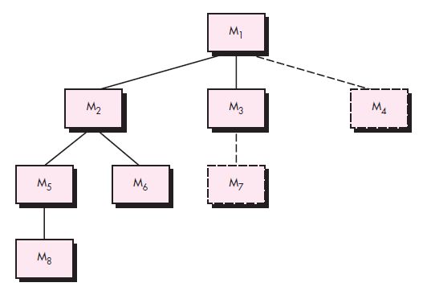
Integration Testing
Top-Down Integration.
Depth-first Integration
Integrates all components on a major control path of the program structure.
Selection of a major path is somewhat arbitrary and depends on application-specific characteristics.

Slide 58
Integration Testing
Top-Down Integration.
Breadth-first Integration
Incorporates all components directly subordinate at each level.
Moving across the structure horizontally.

Slide 59
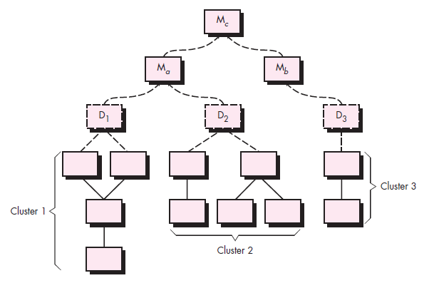
Integration Testing
Bottom-Up Integration.
Bottom-up integration testing, as its name implies, begins construction and testing with atomic modules.
(i.e., components at the lowest levels in the program structure).

Slide 60
Regression Testing
Each time a new module is added as part of integration testing, the software changes.
REGRESSION TESTING is defined as a type of software testing to confirm that a recent program or code change has not adversely affected existing features.

Slide 61
Regression Testing
The regression test suite (the subset of tests to be executed) contains three different classes of test cases:
A representative sample of tests that will exercise all software functions.
Additional tests that focus on software functions that are likely to be affected by the change.
Tests that focus on the software components that have been changed.

Slide 62
Smoke Testing
Smoke testing is an integration testing approach that is commonly used when product software is developed.
Smoke Testing is a software testing process that determines whether the deployed software build is stable or not.
Smoke testing is a confirmation for QA team to proceed with further software testing.
It consists of a minimal set of tests run on each build to test software functionalities.
Smoke testing is also known as "Build Verification Testing" or “Confidence Testing”.

Slide 63
Smoke Testing
The smoke-testing approach encompasses the following activities:
Software components that have been translated into code are integrated into a build.
A series of tests is designed to expose errors that will keep the build from properly performing its function.
The build is integrated with other builds, and the entire product (in its current form) is smoke tested daily.

Slide 64
TESTING CONVENTIONAL APPLICATIONS
White Box Testing
White Box Testing is a software testing technique in which internal structure, design and coding of software are tested to verify flow of input-output and to improve design, usability and security.
In white box testing, code is visible to testers so it is also called Clear box testing, Open box testing, Transparent box testing, Code-based testing and Glass box testing.

Slide 65
TESTING CONVENTIONAL APPLICATIONS
White Box Testing
Using white-box testing methods, you can derive test cases that,
Guarantee that all independent paths within a module have been exercised at least once.
Exercise all logical decisions on their true and false sides.
Execute all loops at their boundaries and within their operational bounds.
Exercise internal data structures to ensure their validity.

Slide 66
TESTING CONVENTIONAL APPLICATIONS
Basis Path Testing
Basis path testing is a white-box testing technique.
Used for designing test cases intended to examine all possible paths of execution at least once.
Before we consider the basis path method, a simple notation for the representation of control flow, called a flow graph (or program graph) must be introduced.

Slide 67
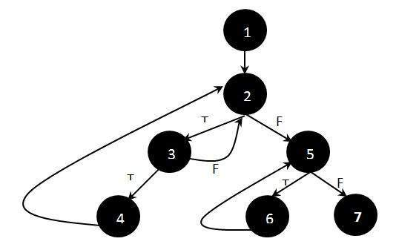
TESTING CONVENTIONAL APPLICATIONS
Basis Path Testing
Steps to Calculate the independent paths
Step 1 : Draw the Flow Graph of the Function/Program under consideration as shown below:

Slide 68
TESTING CONVENTIONAL APPLICATIONS
Basis Path Testing
Steps to Calculate the independent paths
Step 2 : Determine the independent paths.
An independent path is any path through the program that introduces at least one new set of processing statements or a new condition. When stated in terms of a flow graph, an independent path must move along at least one edge that has not been traversed before the path is defined.
Path 1 : 1 – 2 – 5 – 7
Path 2 : 1 – 2 – 5 – 6 – 7
Path 3 : 1 – 2 – 3 – 2 – 5 – 6 – 7
Path 4 : 1 – 2 – 3 – 4 – 2 – 5 – 6 – 7

Slide 69
TESTING CONVENTIONAL APPLICATIONS
Control Structure Testing
Condition Testing
It is a test-case design method that exercises the logical conditions contained in a program module.
A compound condition is composed of two or more simple conditions, Boolean operators, and parentheses.

Slide 70
TESTING CONVENTIONAL APPLICATIONS
Control Structure Testing
Data Flow Testing
Data flow testing is a family of test strategies based on selecting paths through the program's control flow in order to explore sequences of events related to the status of variables or data objects.
Dataflow Testing focuses on the points at which variables receive values and the points at which these values are used.

Slide 71
TESTING CONVENTIONAL APPLICATIONS
Control Structure Testing
Loop Testing
Loop testing is a white-box testing technique that focuses exclusively on the validity of loop constructs.
Four different classes of loops can be defined: simple loops, concatenated loops, nested loops, and unstructured loops.

Slide 72
TESTING CONVENTIONAL APPLICATIONS
Black Box Testing
Black-box testing, also called behavioural testing.
It focuses on the functional requirements of the software.
It will fully exercise all functional requirements for a program.
Black-box testing is not an alternative to white-box techniques.

Slide 73
TESTING CONVENTIONAL APPLICATIONS
Black Box Testing
Black-box testing attempts to find errors in the following categories:
Incorrect or missing functions.
Interface errors.
Errors in data structures or external database access.
Behaviour or performance errors.
Initialization and termination errors.

Slide 74
TESTING CONVENTIONAL APPLICATIONS
Black Box Testing
Tests are designed to answer the following questions:
How is functional validity tested?
How are system behaviour and performance tested?
What classes of input will make good test cases?
Is the system particularly sensitive to certain input values?
How are the boundaries of a data class isolated?
What data rates and data volume can the system tolerate?
What effect will specific combinations of data have on system operation?

Slide 75
TESTING CONVENTIONAL APPLICATIONS
Black Box Testing
Graph-Based Testing Methods
The first step in black-box testing is to understand the objects that are modelled in software and relationships that connect these objects.
The next step is to define a series of tests that verify “all objects have the expected relationship to one another”

Slide 76
TESTING CONVENTIONAL APPLICATIONS
Black Box Testing
Graph-Based Testing Methods
Stated in another way, software testing begins:
By creating a graph of important objects.
Their relationships.
Devising a series of tests that will cover the graph so that each object and relationship is exercised and errors are uncovered.

Slide 77
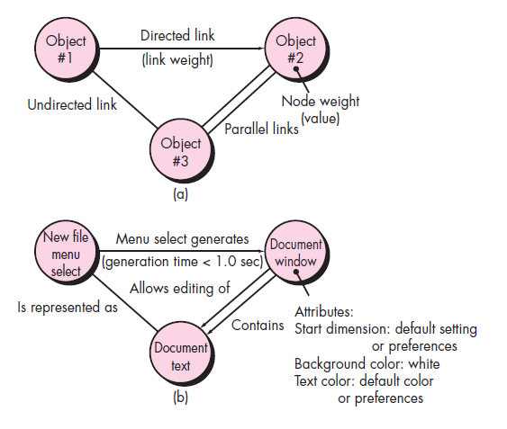
TESTING CONVENTIONAL APPLICATIONS
Black Box Testing
Graph-Based Testing Methods

Slide 78
TESTING CONVENTIONAL APPLICATIONS
Black Box Testing
Graph-Based Testing Methods
Nodes are represented as circles connected by links that take a number of different forms.
A directed link (represented by an arrow) indicates that a relationship moves in only one direction.
A bidirectional link, also called a symmetric link, implies that the relationship applies in both directions.
Parallel links are used when a number of different relationships are established between graph nodes.

Slide 79
Black Box Testing
Equivalence Partitioning
Equivalence partitioning is a black-box testing method.
It divides the input domain of a program into classes of data from which test cases can be derived.
Based on an evaluation of equivalence classes for an input condition.
If a set of objects can be linked by relationships that are symmetric, transitive, and reflexive, an equivalence class is present.

Slide 80
Black Box Testing
Boundary Value Analysis
A greater number of errors occurs at the boundaries of the input domain rather than in the “centre.”
It is for this reason that boundary value analysis (BVA) has been developed as a testing technique.
Boundary value analysis leads to a selection of test cases that exercise bounding values.

Slide 81
Black Box Testing
Orthogonal Array Testing
Orthogonal array testing can be applied to problems in which the input domain is relatively small but too large to accommodate exhaustive testing.
The orthogonal array testing method is particularly useful in finding region faults—an error category associated with faulty logic within a software component.

Slide 82
Model Based Testing
Model-based testing (MBT) is a black-box testing technique that uses information contained in the requirements model as the basis for the generation of test cases.
The model-based testing technique uses UML state diagrams.

Slide 83
Model Based Testing
The MBT technique requires five steps:
Analyse an existing behavioural model for the software or create one.
Traverse the behavioural model and specify the inputs that will force the software to make the transition from state to state.
Review the behavioural model and note the expected outputs as the software makes the transition from state to state.
Execute the test cases.
Compare actual and expected results and take corrective action as required.

Slide 84
Model Based Testing
The MBT technique requires five steps:
Analyse an existing behavioural model for the software or create one.
Traverse the behavioural model and specify the inputs that will force the software to make the transition from state to state.
Review the behavioural model and note the expected outputs as the software makes the transition from state to state.
Execute the test cases.
Compare actual and expected results and take corrective action as required.

Slide 85
Testing Object Oriented Applications
The architecture of object-oriented (OO) software results in a series of layered subsystems that encapsulate collaborating classes.
Each of these system elements (subsystems and classes) performs functions that help to achieve system requirements.

Slide 86
Testing Object Oriented Applications
It is necessary to test an OO system at a variety of different levels.
To uncover errors that may occur as classes collaborate with one another and subsystems communicate across architectural layers.

Slide 87
Object Oriented Testing Strategies
Unit Testing in the OO Context.
When object-oriented software is considered, the concept of the unit changes.
Encapsulation drives the definition of classes and objects.
This means that each class and each instance of a class (object) packages attributes (data) and the operations (also known as methods or services) that manipulate these data.

Slide 88
Object Oriented Testing Strategies
Unit Testing in the OO Context.
Rather than testing an individual module, the smallest testable unit is the encapsulated class.
Because a class can contain a number of different operations.
A particular operation may exist as part of a number of different classes.
The meaning of unit testing changes dramatically.

Slide 89
Object Oriented Testing Strategies
Integration Testing in the OO Context
There are two different strategies for integration testing of OO systems.
Thread-based testing
Integrates the set of classes required to respond to one input or event for the system. Each thread is integrated and tested individually.
use-based testing
Begins the construction of the system by testing those classes (called independent classes) that use very few (if any) of server classes.

Slide 90
Object Oriented Testing Strategies
Integration Testing in the OO Context
After the independent classes are tested, the next layer of classes, called dependent classes, that use the independent classes are tested.
This sequence of testing layers of dependent classes continues until the entire system is constructed.

Slide 91
Object Oriented Testing Strategies
Validation Testing in an OO Context
At the validation or system level, the details of class connections disappear.
Like conventional validation, the validation of OO software focuses on user-visible actions and user-recognizable outputs from the system.

Slide 92
Object Oriented Testing Strategies
Validation Testing in an OO Context
At the validation or system level, the details of class connections disappear.
Like conventional validation, the validation of OO software focuses on user-visible actions and user-recognizable outputs from the system.

Slide 93
Object Oriented Testing Methods
Fault Based Testing
Tests for potential faults.
The object of fault-based testing within an OO system is to design tests that have a high likelihood of uncovering plausible faults.
Fault-based testing begins with the analysis model.
Because the product or system must conform to customer requirements.

Slide 94
Object Oriented Testing Methods
Test Cases and the Class Hierarchy
Inheritance does not obviate the need for thorough testing of all derived classes.
In fact, it can actually complicate the testing process.

Slide 95
Object Oriented Testing Methods
Scenario-Based Test Design
Fault-based testing misses two main types of errors:
Incorrect specifications and
Interactions among subsystems.

Slide 96
Object Oriented Testing Methods
Scenario-Based Test Design
Fault-based testing misses two main types of errors:
Incorrect specifications
When errors associated with an incorrect specification occur, the product doesn’t do what the customer wants.
It might do the wrong thing or omit important functionality. But in either circumstance, quality (conformance to requirements) suffers.

Slide 97
Object Oriented Testing Methods
Scenario-Based Test Design
Fault-based testing misses two main types of errors:
Interactions among subsystems.
Errors associated with subsystem interaction occur when the behaviour of one subsystem creates circumstances (e.g., events, data flow) that cause another subsystem to fail.

Slide 98
Object Oriented Testing Methods
Scenario-Based Test Design
Scenario-based testing concentrates on what the user does, not what the product does.
This means capturing the tasks (via use cases) that the user has to perform and then applying them and their variants as tests.
Scenario-based testing tends to exercise multiple subsystems in a single test.

Slide 99
Object Oriented Testing Methods
Testing Surface Structure and Deep Structure
Surface structure refers to the externally observable structure of an OO program.
That is, the structure that is immediately obvious to an end user.
Rather than performing functions, the users of many OO systems may be given objects to manipulate in some way.
But whatever the interface, tests are still based on user tasks.
Capturing these tasks involves understanding, watching, and talking with representative users.

Slide 100
Object Oriented Testing Methods
Testing Surface Structure and Deep Structure
Deep structure refers to the internal technical details of an OO program.
That is, the structure that is understood by examining the design and/or code.
Deep structure testing is designed to exercise:
Dependencies
Behaviours
communication mechanisms

Slide 101
TESTING METHODS APPLICABLE AT THE CLASS LEVEL
Random Testing for OO Classes
consider a banking application in which an Account class has the following operations:
open(), setup(), deposit(), withdraw(),balance(), summarize(), creditLimit(), and close().
The account must be opened before other operations can be applied and closed after all operations are completed.

Slide 102
TESTING METHODS APPLICABLE AT THE CLASS LEVEL
Partition Testing at the Class Level
Partition testing reduces the number of test cases required to exercise the class.
Much same as equivalence portioning.
State-based partitioning categorizes class operations based on their ability to change the state of the class.
Attribute-based partitioning categorizes class operations based on the attributes that they use.

Slide 103
TESTING WEB APPLICATIONS
What is it?
WebApp testing is a collection of related activities with a single goal: to uncover errors in WebApp content, function, usability, navigability, performance, capacity, and security.

Slide 104
TESTING WEB APPLICATIONS
Who does it?
Web engineers and other project stakeholders (managers, customers, end users) all participate in WebApp testing.

Slide 105
TESTING WEB APPLICATIONS
Why is it important?
If end users encounter errors that shake their faith in the WebApp, they will go elsewhere for the content and function they need, and the WebApp will fail.
For this reason, you must work to eliminate as many errors as possible before the WebApp goes online.

Slide 106
TESTING WEB APPLICATIONS
What are the steps?
The WebApp testing process begins by focusing on user-visible aspects of the WebApp and proceeds to tests that exercise technology and infrastructure.
Seven testing steps are performed: content testing, interface testing, navigation testing, component testing, configuration testing, performance testing, and security testing.

Slide 107
TESTING WEB APPLICATIONS
Testing concepts for Web Apps
Web-based systems and applications reside on a network and interoperate with many different operating systems, browsers (residing on a variety of devices), hardware platforms, communications protocols, and “backroom” applications, the search for errors represents a significant challenge.
To understand the objectives of testing within a Web engineering context, you should consider the many dimensions of WebApp quality.

Slide 108
TESTING WEB APPLICATIONS
Testing concepts for Web Apps
Dimensions of Quality
Quality is incorporated into a Web application as a consequence of good design.
It is evaluated by applying reviews and testing.
Content is evaluated at both a syntactic and semantic level.
At the syntactic level, spelling, punctuation, and grammar are assessed for text-based documents.
At a semantic level, correctness (of information presented), consistency (across the entire content object and related objects), and lack of ambiguity are all assessed.

Slide 109
TESTING WEB APPLICATIONS
Testing concepts for Web Apps
Dimensions of Quality
Function is tested to uncover errors that indicate lack of conformance to customer requirements.
Structure is assessed to ensure that it properly delivers WebApp content and function.
Usability is tested to ensure that each category of user is supported by the interface and can learn and apply all required navigation syntax and semantics.

Slide 110
TESTING WEB APPLICATIONS
Testing concepts for Web Apps
Dimensions of Quality
Navigability is tested to ensure that all navigation syntax and semantics are exercised to uncover any navigation errors.
Performance is tested under a variety of operating conditions, configurations, and loading to ensure that the system is responsive to user interaction and handles extreme loading without unacceptable operational degradation.

Slide 111
TESTING WEB APPLICATIONS
Testing concepts for Web Apps
Dimensions of Quality
Compatibility is tested by executing the WebApp in a variety of different host configurations on both the client and server sides (Tests uniquely the host configuration).
Interoperability is tested to ensure that the WebApp properly interfaces with other applications and/or databases.
Security is tested by assessing potential vulnerabilities and attempting to exploit each.

Slide 112
TESTING WEB APPLICATIONS
Testing concepts for Web Apps
Errors within a WebApp Environment
Errors encountered as a consequence of successful WebApp testing have a number of unique characteristics:
Because many types of WebApp tests uncover problems that are first evidenced on the client side, you often see a symptom of the error, not the error itself.
Because a WebApp is implemented in a number of different configurations and within different environments, it may be difficult or impossible to reproduce an error outside the environment in which the error was originally encountered.

Slide 113
TESTING WEB APPLICATIONS
Testing concepts for Web Apps
Errors within a WebApp Environment
Although some errors are the result of incorrect design or improper HTML (or other programming language) coding, many errors can be traced to the WebApp configuration.
Because WebApps reside within a client-server architecture, errors can be difficult to trace across three architectural layers: the client, the server, or the network itself.

Slide 114
TESTING WEB APPLICATIONS
Testing concepts for Web Apps
Errors within a WebApp Environment
Some errors are due to the static operating environment (Testing environment), while others are attributable to the dynamic operating environment.
These five error attributes suggest that environment plays an important role in the diagnosis of all errors uncovered during the WebApp testing.

Slide 115
TESTING WEB APPLICATIONS
Testing concepts for Web Apps
Testing Strategy

